Slide 1
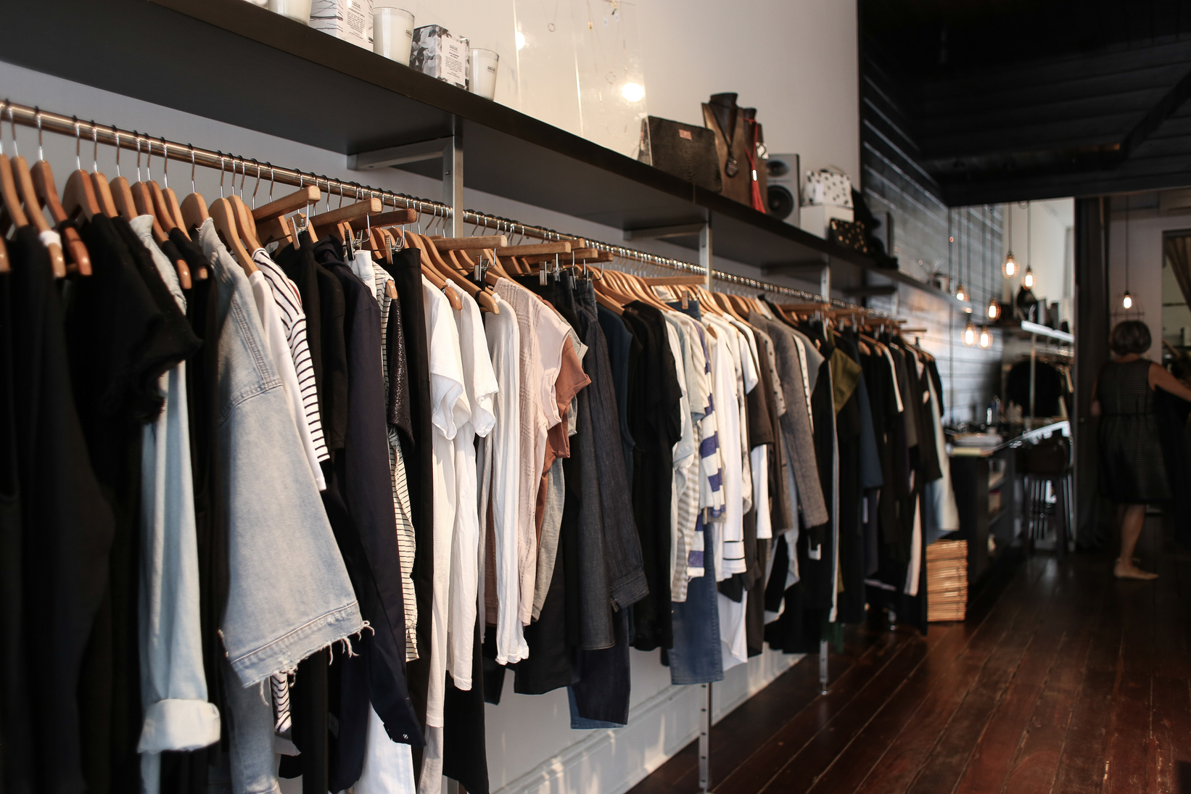

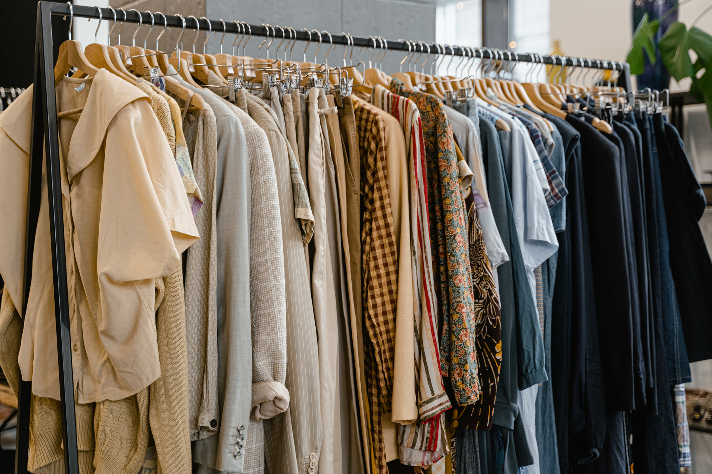

STYLESTOCK
CLOTHING MANAGAGEMNET SYSTEM

Slide 2
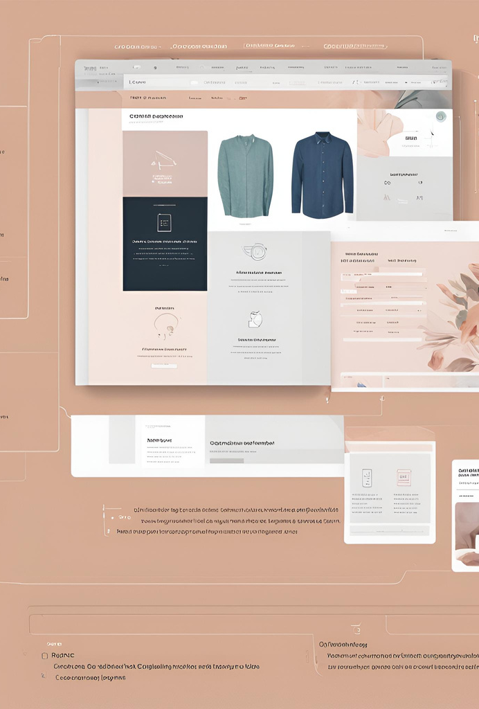
ABOUT
A website designed to streamine and organise the operation of a colthing store or warehouse
Users interact with the system through a menu-driven interface, making it intuitive to perform tasks
Help in easy tracking of shipments and and deliveries
Enhancing the security systems of clothing stores and warehouses
STYLESTOCK

Slide 3


PROBLEMS IN TODAY’S SYSTEMS
COMPLEXITY
INTEGRATION ISSUES
INACCURATE TRACKING
LACK OF CUSTOMIZATION
NO STRICT SECURITY SYSTEM
STYLESTOCK

Slide 4


THIS IN TURN CAUSES:
ONLINE THEFTS
LOOSING CERTAIN ITEMS
WASTING MONEY ON BUYING EXCESS GOODS
INCREASING TEXTILE WASTE MATERIAL
STYLESTOCK

Slide 5
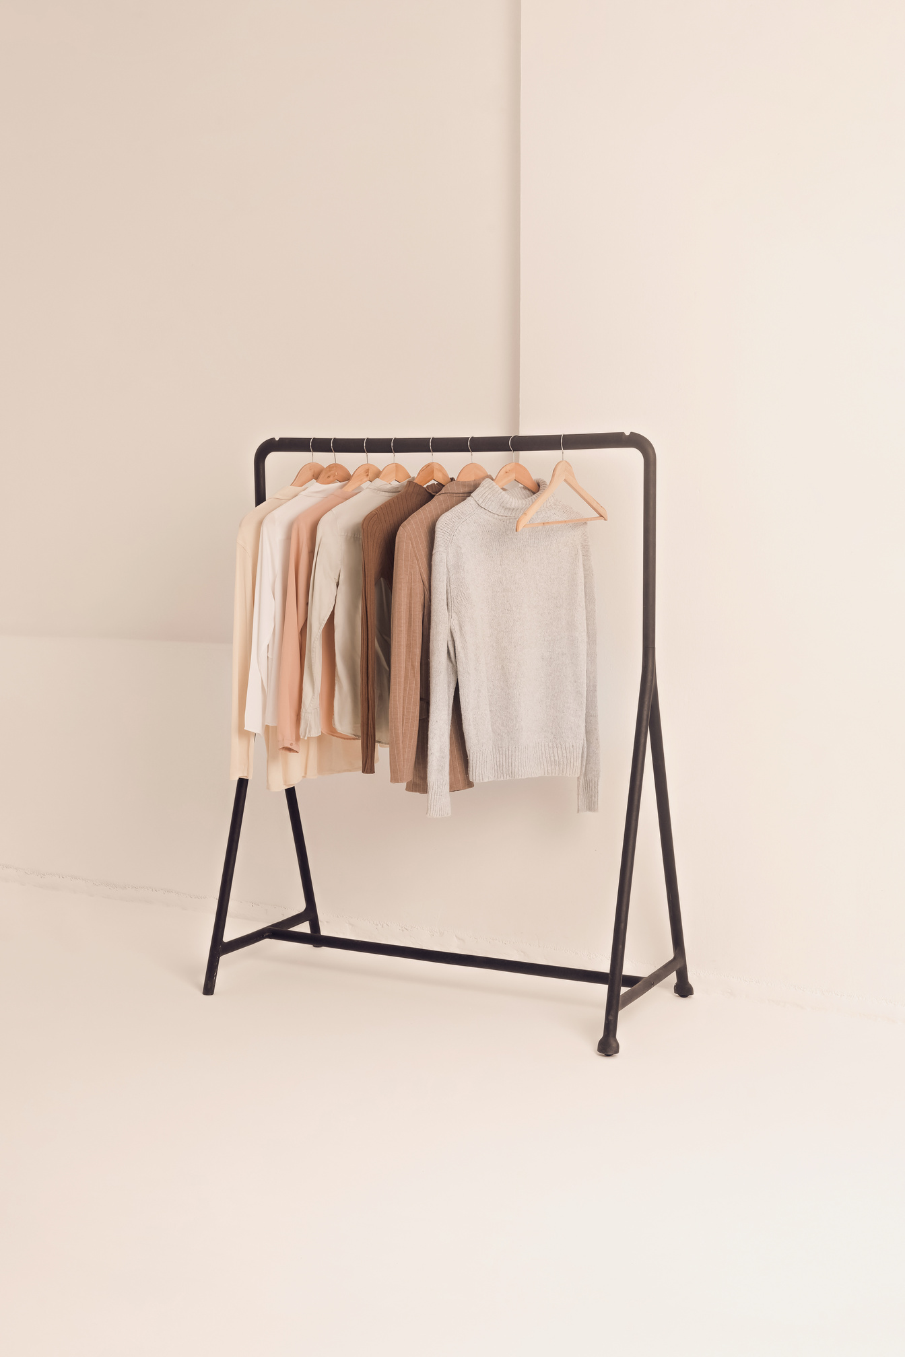
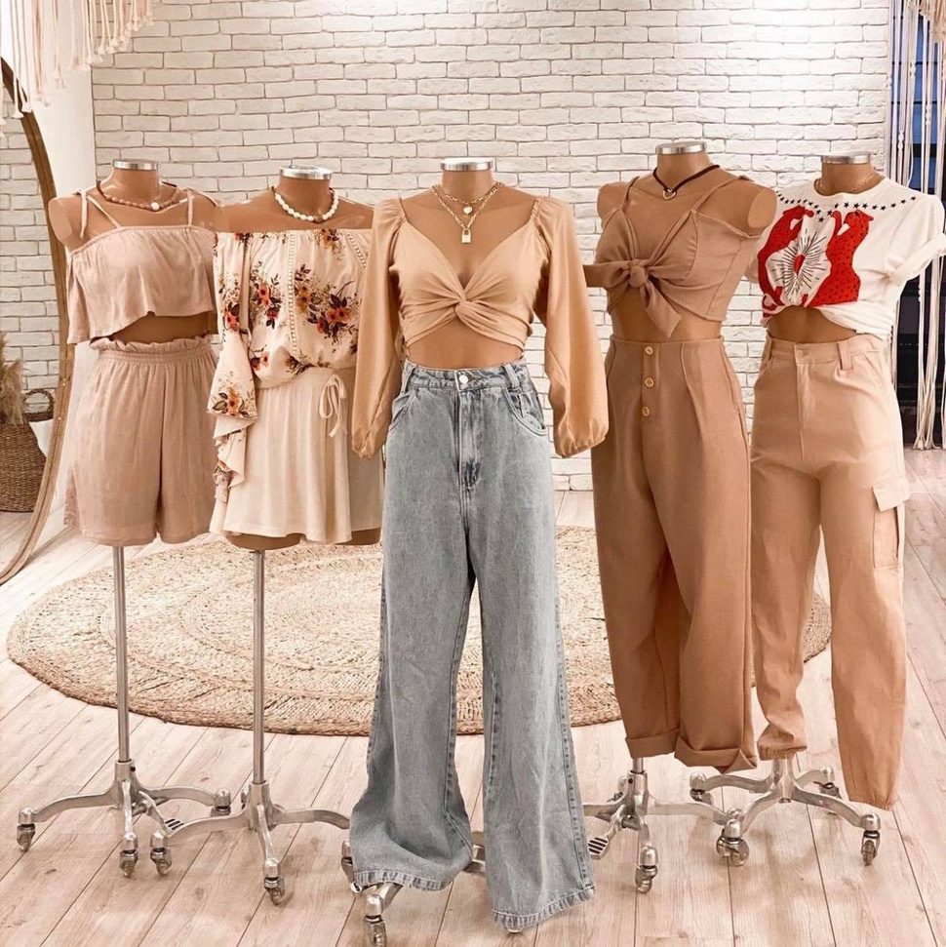
SOLUTIONS
SIMPLIFY DESIGN
ENHANCE INTEGRATION
IMPROVE ACCURACY AND SECURITY
ALLOW CUSTOMIZATION
TRACK TRENDS
STYLESTOCK

Slide 6
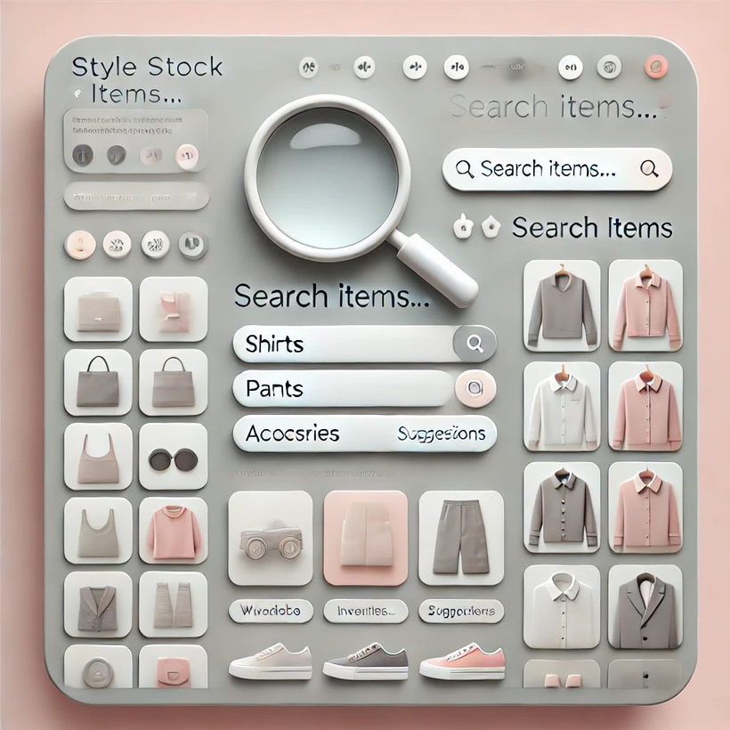
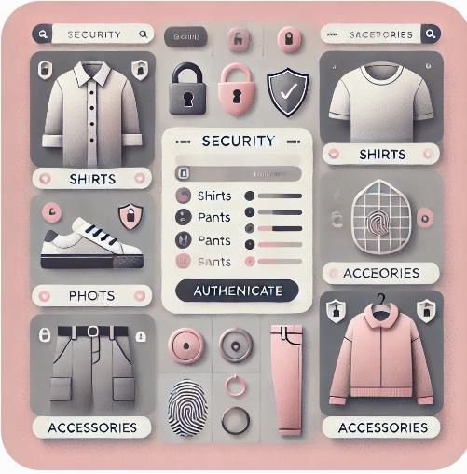
VISUAL REPRESENTATION OF OUR WEBSITE

Slide 7

TIMELINE
WEEK 4-5:
Algorithm Development
Working on forming the code
WEEK 1:
Project Initiation
Defining the idea of the Project
WEEK 2-3:
Project design
Finalizing the concept and design layout
WEEK 6-7:
User Testing
Testing the code for user interaction
STYLESTOCK

Slide 8
WEEK 12-13:
Final Testing
Testing of entire website
WEEK 8-9:
Security Development
Working on the Security System
WEEK 10-11:
Creating Website
Adding the code and inventory to the website
WEEK 14:
Product Launch
Presenting the entire project
STYLESTOCK

Slide 9
STYLE SIMPLIFIED: STREAMLINE YOUR WARDROBE WITH EASE
Inspired by the principles of Marie Kondo
STYLESTOCK

Slide 10
THANK YOU

